Slide 1

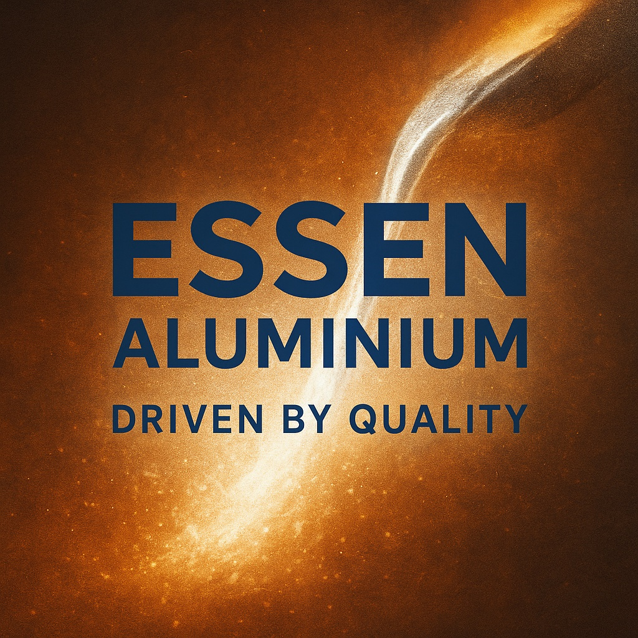
COMPANY PROFILE
M-42 INDUSTRIAL ESTATE UDYAMBAG BELGAUM-590008

Slide 2
Table of Content
About Company
Vision & Mission
Our Products
Our Customers
Contact us

Slide 3
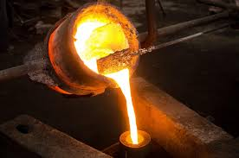
About Company
We introduce ourselves as an ISO 9001:2015 certified foundry. This unit was started in 1971 by Mr. B. L. Kamat, later on joined by Mr. S. B. Kamat D.M.E.& Mr .Vardhan .S. Kamat (B.E. Mech) We are casting manufacturing company and produce all types of Non-ferrous castings i.e. Copper based alloys. The castings are produced by Sand, Gravity die, Centrifugal.

Slide 4
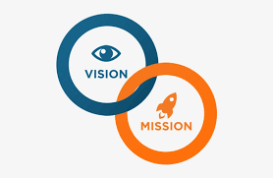
Mission
To Manufacture high quality non-ferrous castings through innovation, precision and sustainable practices – delivering reliable solutions that empower our customers growth.
To manufacture efficient components that meet evolving needs of industries worldwide
Vision
To be the most trusted and innovative non-ferrous foundry recognizes for world-class quality, technology and reliability.
To become a globally respected non-ferrous foundry known for sustainable manufacturing, exceptional quality and customer–centric solutions.

Slide 5
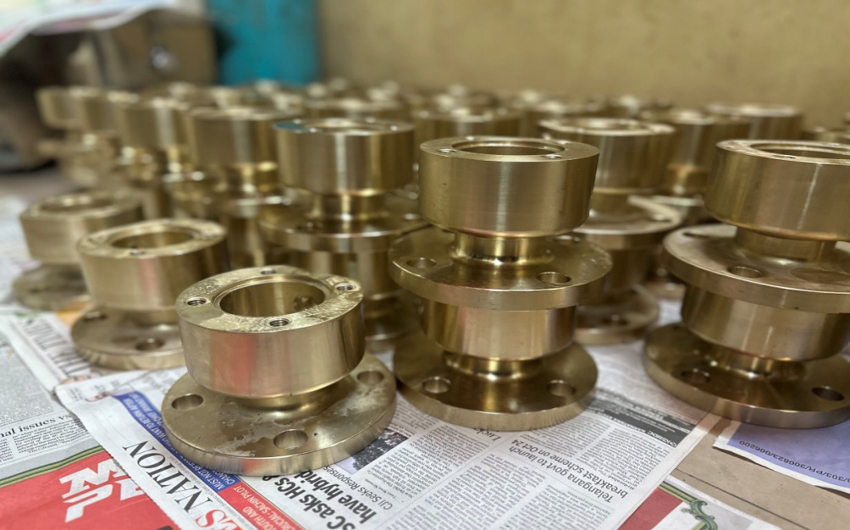
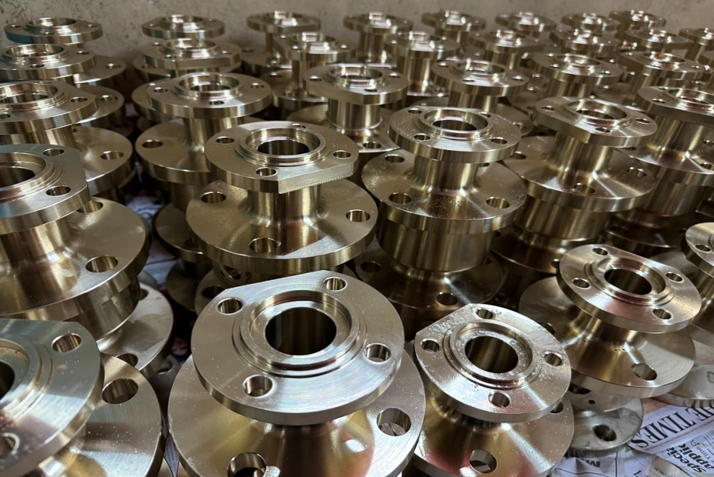
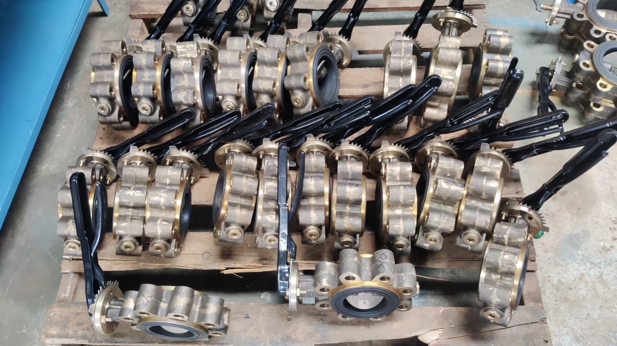
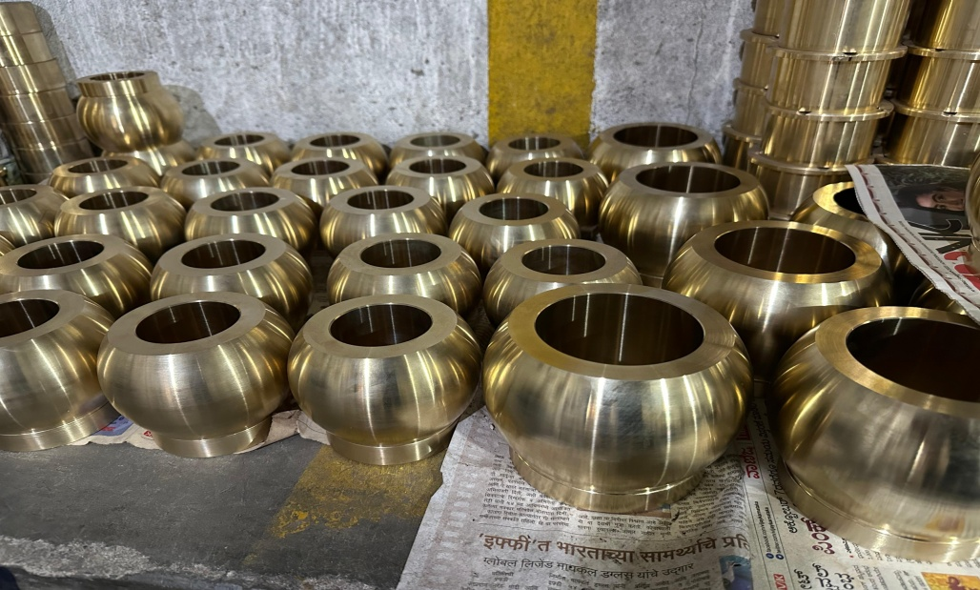
Our Products (Valves)

Slide 6
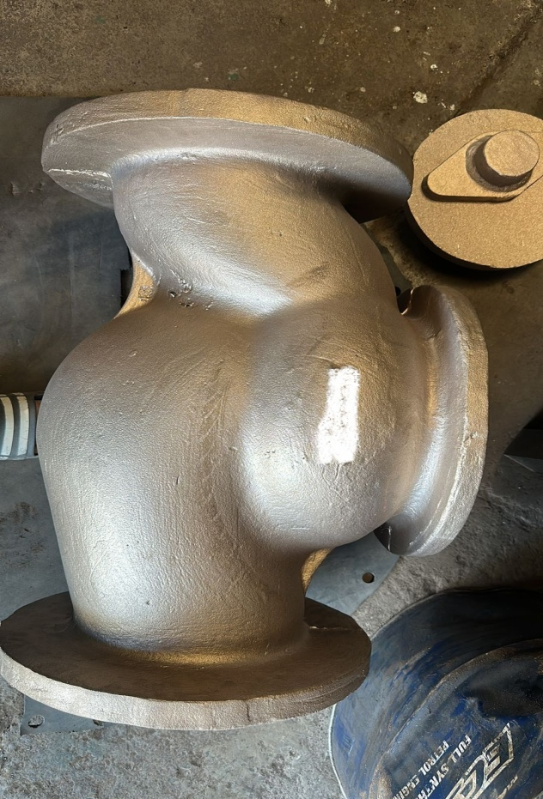
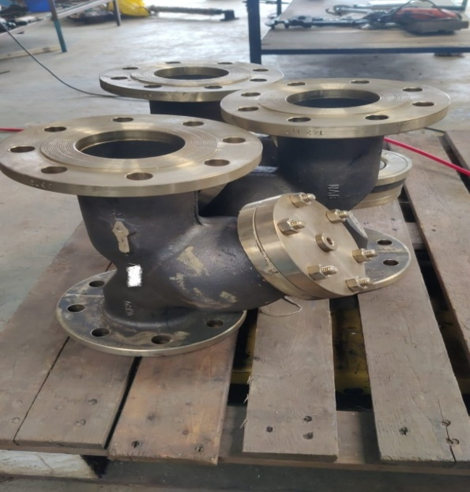
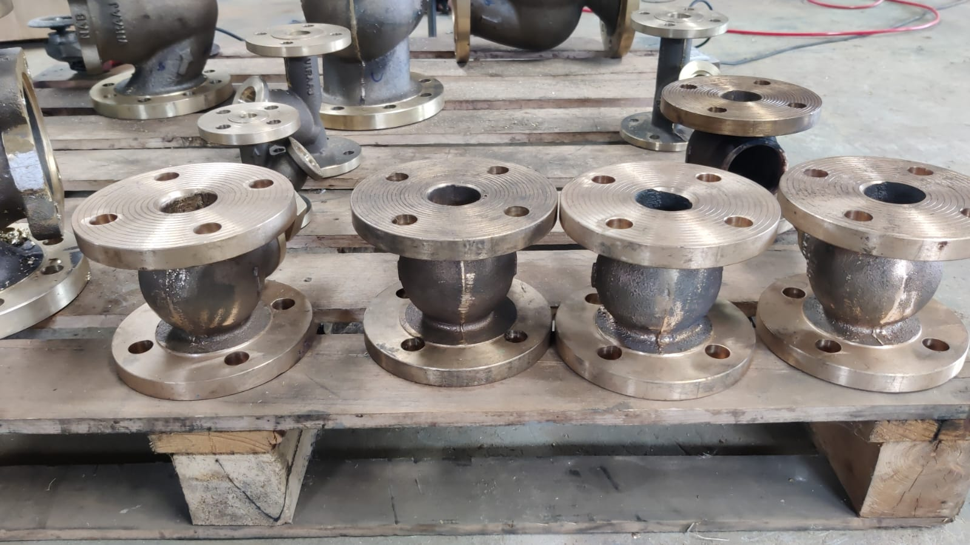
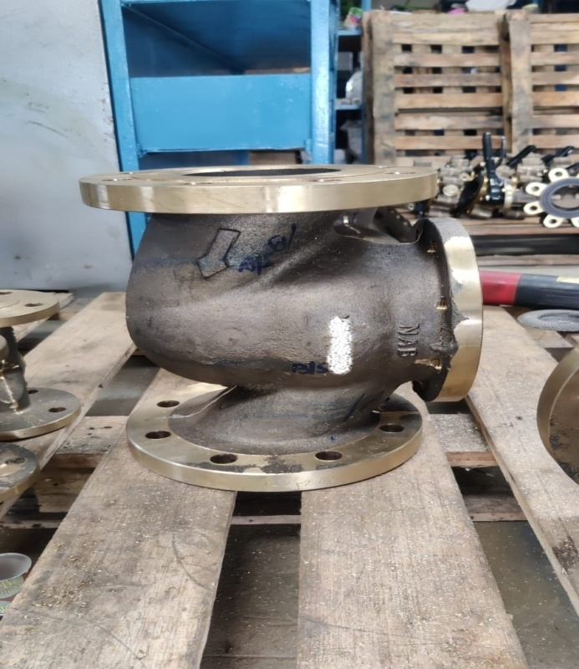
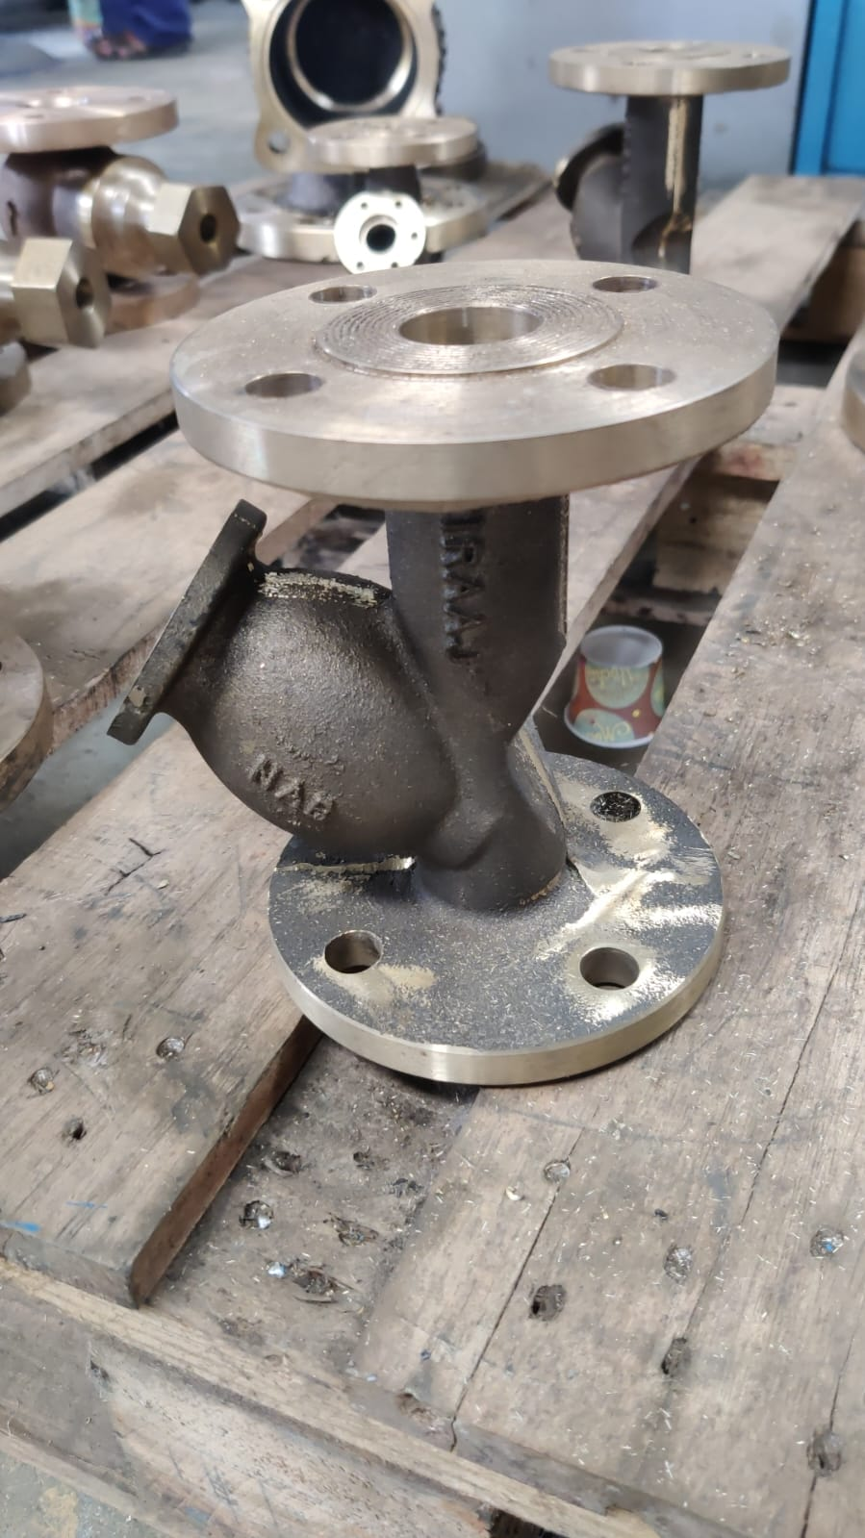
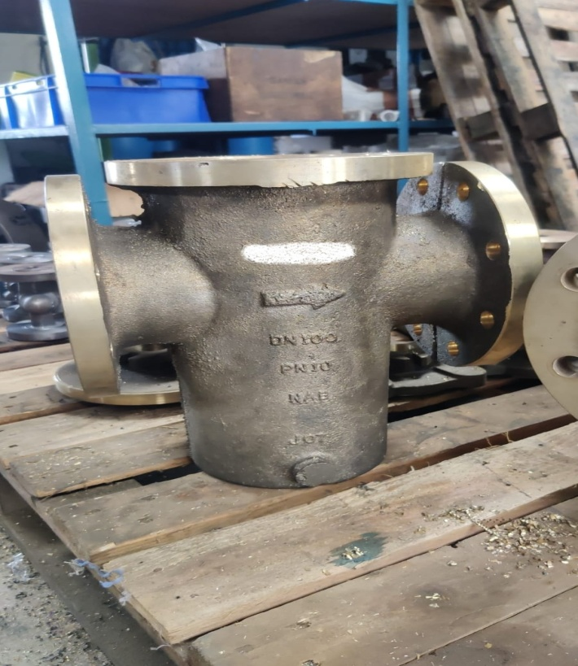

Slide 7
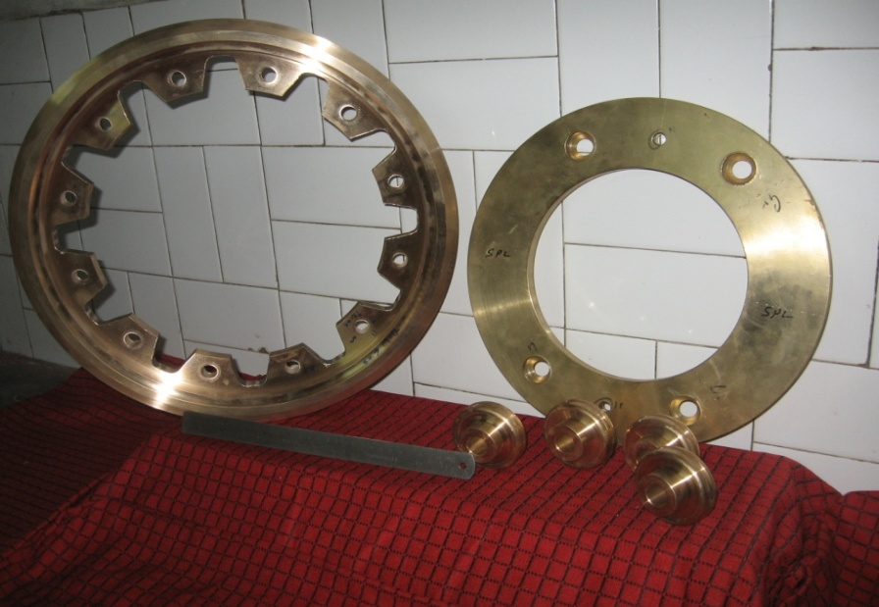
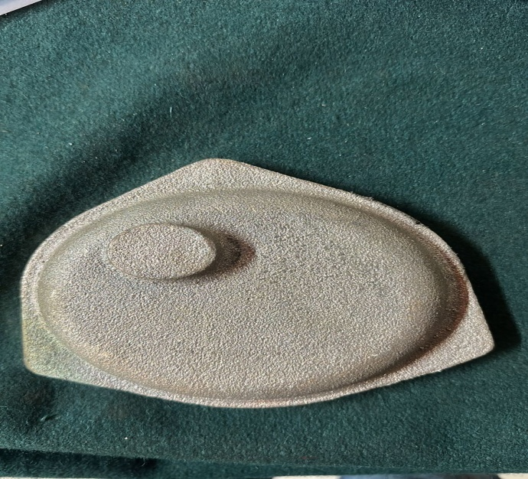
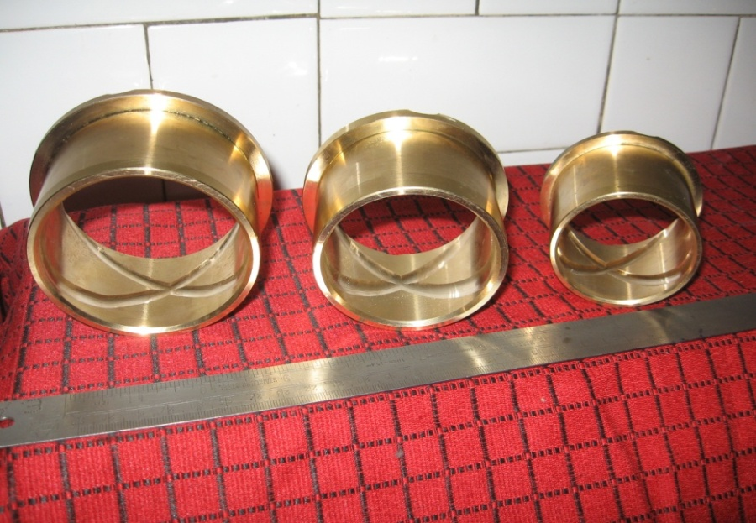
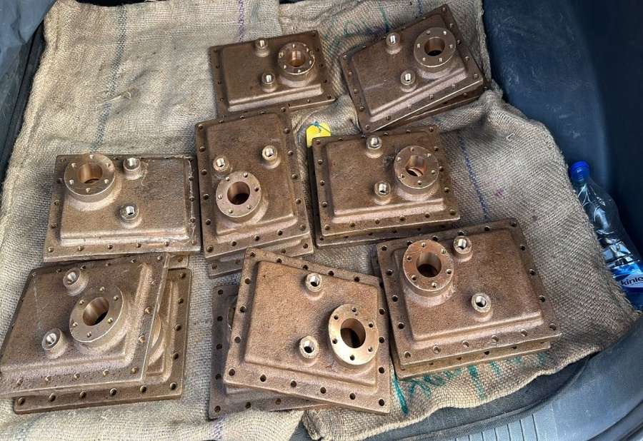
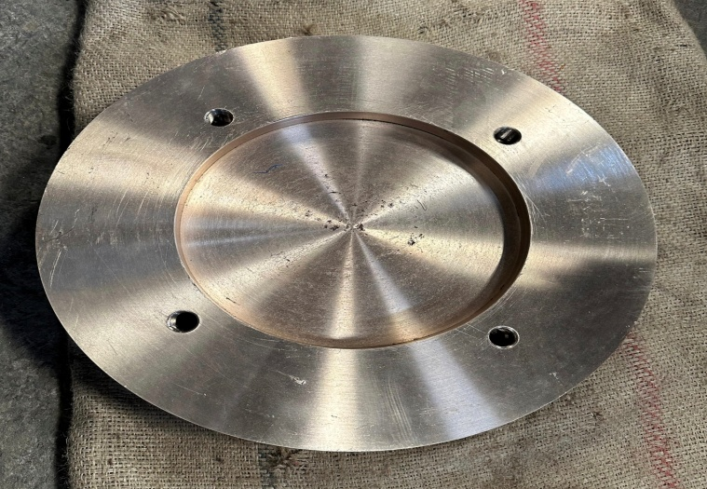
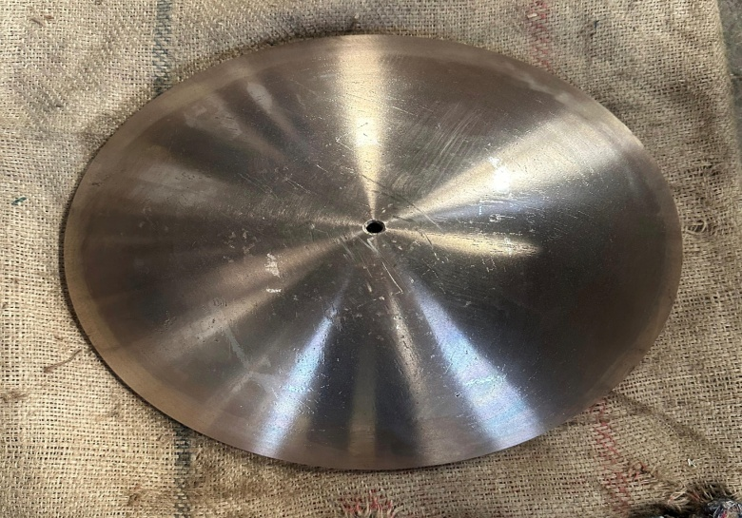
General Engg Components

Slide 8
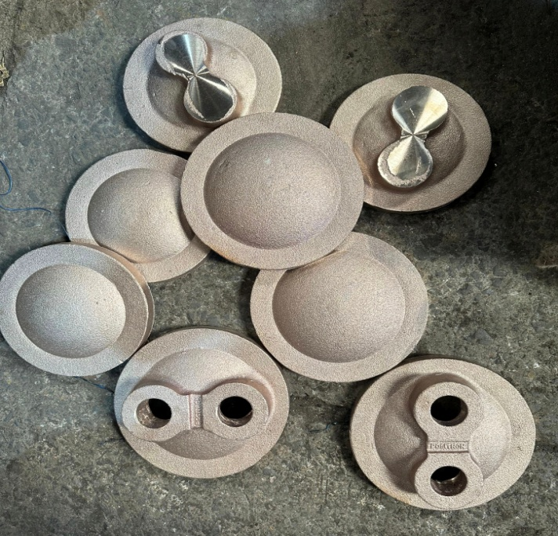
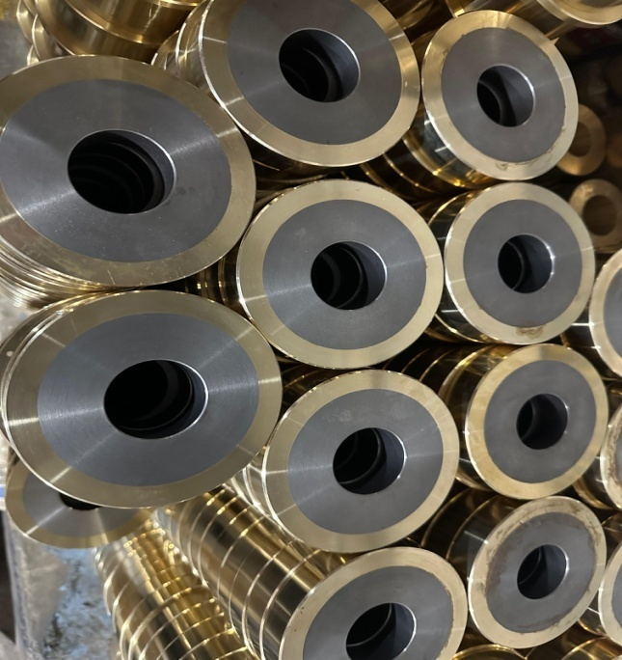
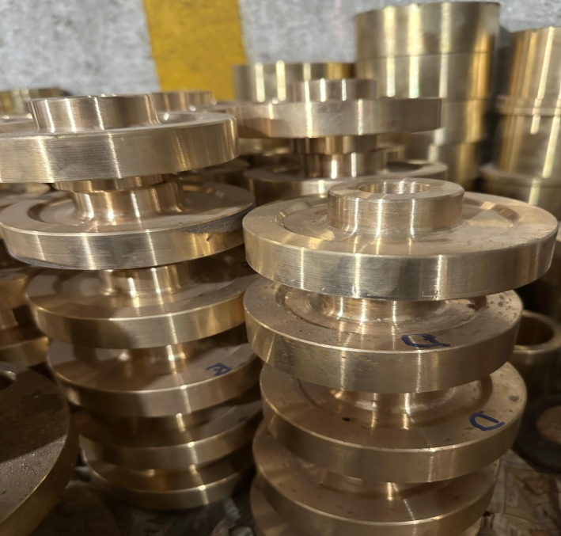
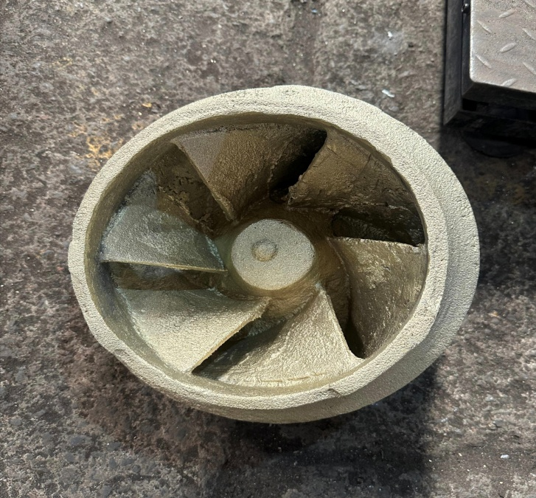
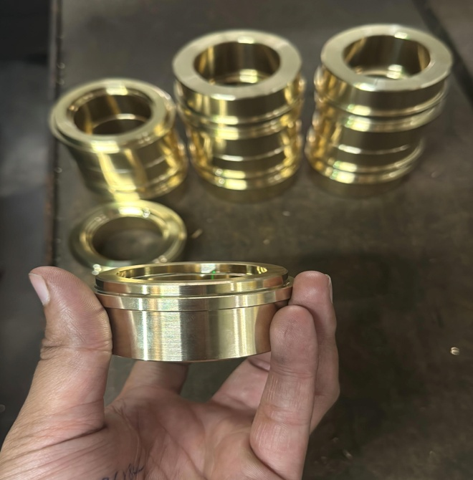
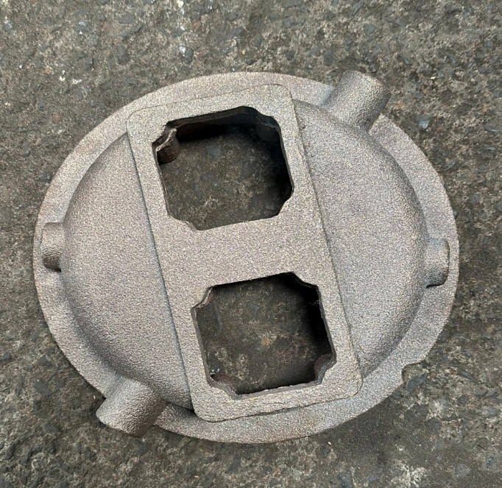

Slide 9
Our Customers
Company 1
Company 2
Company 3
Company 4
TATA HITACHI
JSW
RELIANCE GROUP
KIRLOSKAR GROUP
BEML GROUP
AND MANY OTHER PUBLIC & PVT LTD FIRMS

Slide 10


Let’s Connect with us!
+91 9448145013
+91 8971580159
essenaluminium@gmail.com
Udyambag, Belgaum.
.

